Slide 1
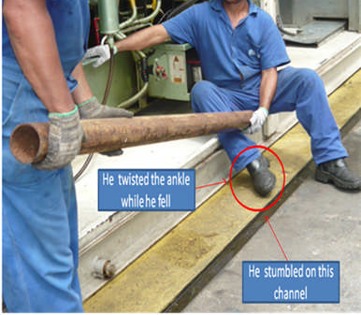
HS&E INCIDENT BULLETIN |  | 1st half year 2014
Brazil | Type of incident - Slip/Trip/Fall from same level
Summary:
The injured employee and manager was carrying a pipe and walking backwards. When they moved to place the pipe in its intended location, the employee stumbled on an open channel and fell onto the ground, twisting his right ankle. Employee was diagnosed with a broken fibula.
Root Causes: | Actions Taken Thus Far: Next Steps
Uncovered channel creating uneven work surface. | Cover channels to eliminate uneven surfaces, use portable hoist instead of manually moving.

